Slide 1

Capstone Project – Real Estate
Boston Housing Dataset
By:
Vishal V
Ram Singh
Shreya Ruge
Dr. Vishnu Vardhan
October 29, 2017

Slide 2
Contents
Overview of the project
Data Description
Data Exploration
Data Preparation
Model Building : Multiple Linear Regression models
Summary of the Model
Performance of the Model
Model Diagnostics
Final Conclusion of the Project – Insights Derived and Recommendation
References
Codes

Slide 3
Overview of the project
The objective of our project was to understand the drivers behind the value of houses in Boston and arrive at data-driven recommendations on how the client can increase the value of housing.
The housing dataset contains 506 observations of 14 variables.
As the dependent variable MEDV (Median prices) is continuous, we had implemented the Multiple Linear regression approach.
The project document is organized to demonstrate the entire process right from: Exploring the data, Cleaning the data, model building, prediction, model performance and understanding the importance of various features in influencing the housing prices.

Slide 4
Data Description
Variable | Description
CRIM | per capita crime rate by town
ZN | proportion of residential land zoned for lots over 25,000 sq.ft.
INDUS | proportion of non-retail business acres per town.
CHAS | Charles River dummy variable (1 if tract bounds river; 0 otherwise)
NOX | nitric oxide concentration (parts per 10 million)
RM | average number of rooms per dwelling
AGE | proportion of owner-occupied units built prior to 1940
DIS | weighted distances to five Boston employment centres
RAD | index of accessibility to radial highways
TAX | full-value property-tax rate per $10,000
PTRATIO | pupil-teacher ratio by town
B | 1000(Bk - 0.63)^2 where Bk is the proportion of blacks by town
LSTAT | % lower status of the population
MEDV | Median value of owner-occupied homes in $1000

Slide 5
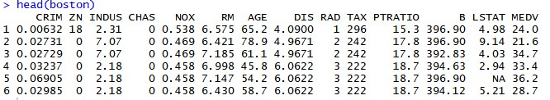
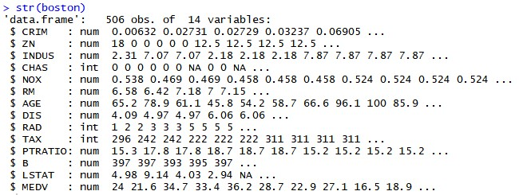
Data Exploration

Slide 6
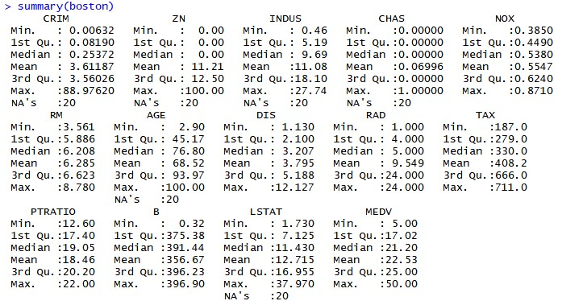
Data Exploration – cont’d

Slide 7
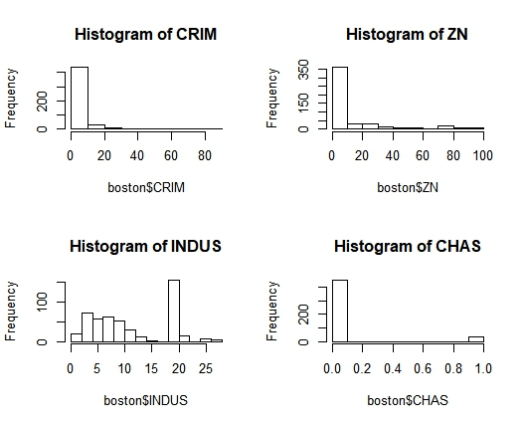
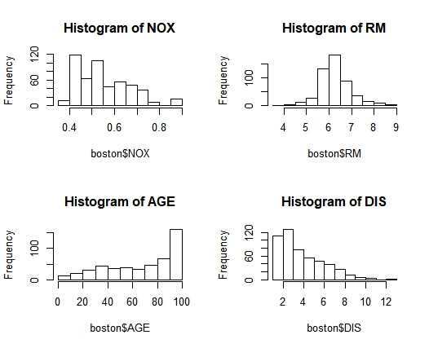
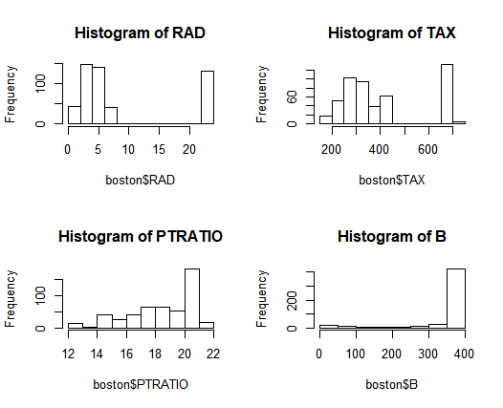
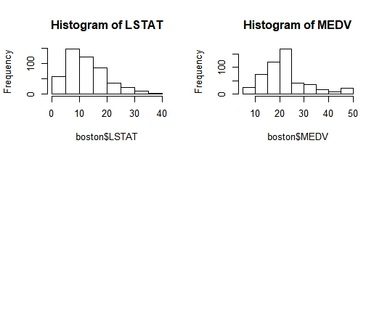
Data Exploration – Histograms

Slide 8
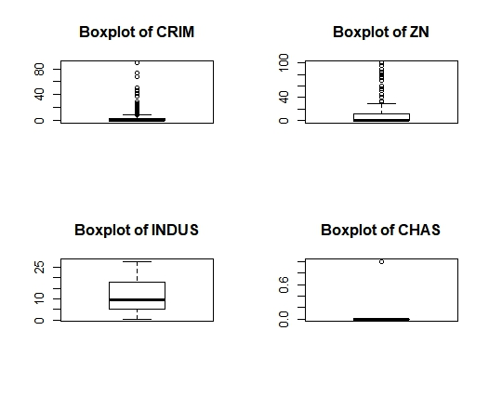
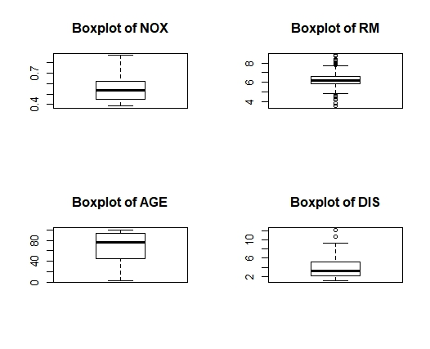
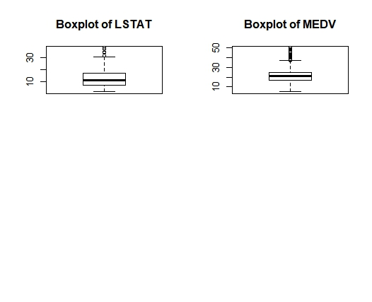
Data Exploration – Boxplots

Slide 9
Data Exploration – Study of Potential Variables
CRIME RATE PER TOWN (CRIM)
CRIM < 10 | 435 Observations
CRIM > 50 | 4 Observations
CRIM > 80 | 1 Observation
AVERAGE NUMBER OF ROOMS (RM)
RM > 7 | 64 Observations
RM > 8 | 13 Observations
RM < 4 | 2 Observations
RM < 3 | None
BOUND THE CHARLES RIVER OR NOT (CHAS)
CHAS = 1 | 32 Observations
CHAS = 0 | 452 Observations
FULL-VALUE PROPERTY TAX RATE PER $ 10,000 (TAX)
TAX > 600 | 137 Observations
TAX < 600 | 69 Observations

Slide 10

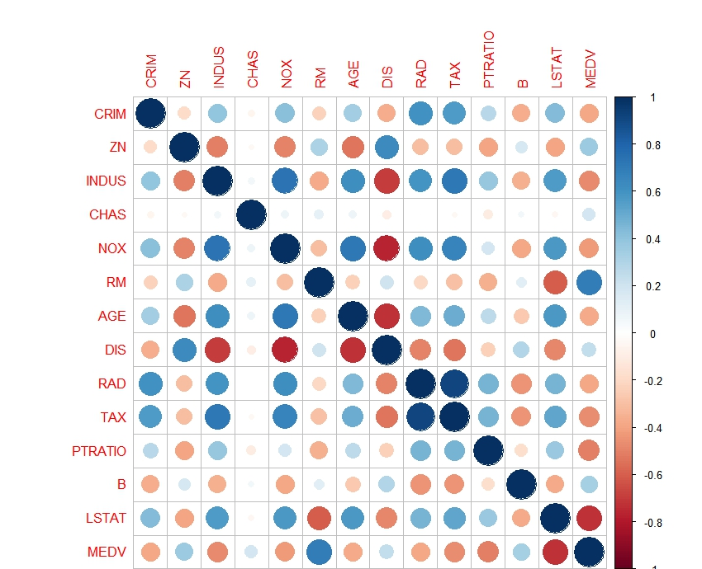
Data Exploration – Correlation Analysis
Positive correlations are displayed in blue and negative correlations in red colour.
Colour intensity and the size of the circle are proportional to the correlation coefficients.
Variables are highly correlated to itself.(example: CRIM with CRIM, ZN with ZN, etc.)

Slide 11

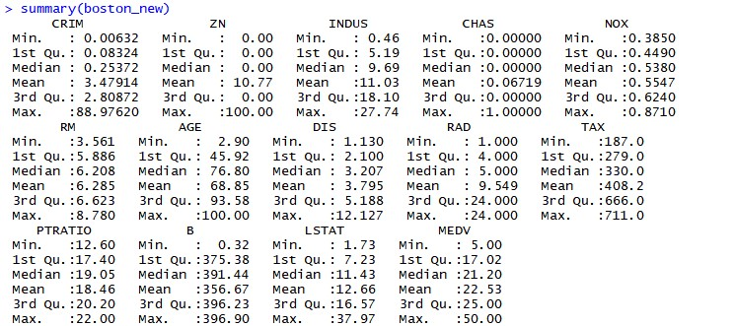
Data Preparation – Missing Value Treatment
NA values in variables replaced by their Median values
Notes:
We have tried omitting NA values, replacing NA with mean and median. Out of these approaches, replacing NA with median proved to show better result in terms of model performance

Slide 12
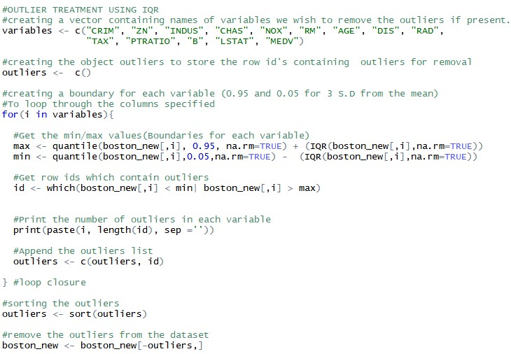
Data Preparation – Outlier Treatment
Notes:
Outlier treatment by the means of Inter Quartile range.

Slide 13
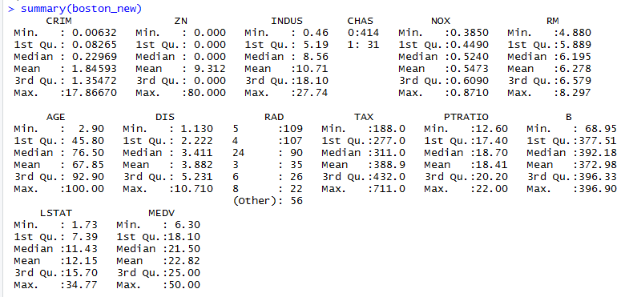
Data Preparation – Outlier Treatment
Outlier /extreme values in data set are identified as it will change fit estimates and predictions
Data has been cleaned by eliminating rows that contain the outliers.
Summarized view of data after outlier treatment is shown below.

Slide 14

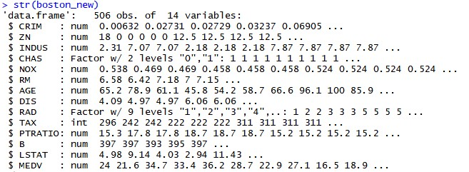
Data Preparation – cont’d
CHAS and RAD are now factors.

Slide 15

Model Building: Data partition
The dataset now contains 445 observations of 14 variables.
Splitting the dataset into train and test data.
The train dataset is containing 311 observations, while the test dataset contains 134 observations. The model will be trained using the train data and will be validated using the test data.
The model will use the log transformed MEDV variable.

Slide 16
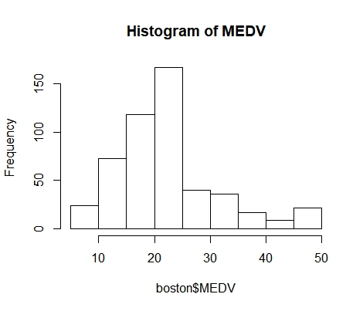
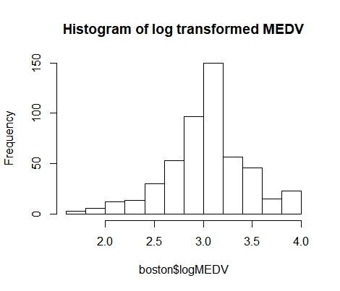
Model Building : Log transformation of MEDV
Why to log transform the MEDV variable?
Log transformation is done to transform a skewed distribution to a normal distribution. This is also a common practise to tackle heteroskedasticity
Based on the approaches we had taken, there was considerable improvement in model performance when MEDV was log transformed.
The following histograms shows you that log transformation of MEDV has transformed its earlier skewed distribution to a normal distribution.

Slide 17
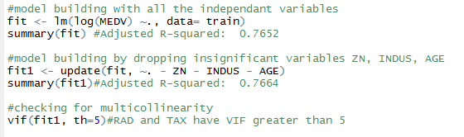
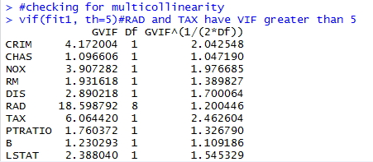
Model Building : Multiple linear regression model
We build the first model “fit” with log transformed MEDV and include all the independent variables.
Muliticollinearity present in RAD and TAX. They have VIF greater than 5.
Will build the next model by dropping variables RAD and TAX

Slide 18

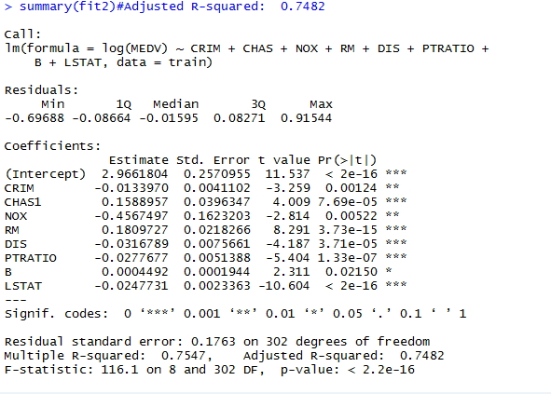
Model Summary

Slide 19
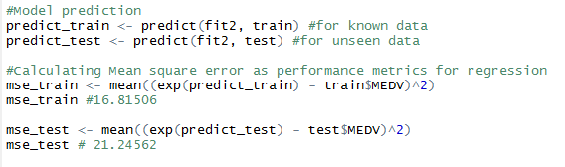
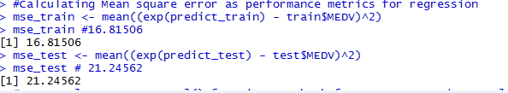
Performance of the Model

Slide 20
Performance of the Model (cont’d)
Comparing our model to a model without log transformed MEDV, we discovered the following:
Performance metric | Model with log transformed MEDV | Model without log transformed MEDV
Mean Square Error(MSE) | 21.2456 | 24.1225
Adjusted R-squared value | 0.7482 | 0.7093
The MSE value and Adjusted R-squared value are better in our model compared to a model without log transformation of MEDV.

Slide 21

Model Diagnostics
To check If the model satisfies the assumptions of linear regression
Assumption: Errors are not autocorrelated.
We employ durbinWatsonTest from car package.
Null hypothesis says errors are not autocorrelated. They are independent. While Alternate hypothesis says errors are autocorrelated.
Since the p value is greater than 0.05, we satisfy Null hypothesis. In other words, we failed to reject the Null hypothesis.
The DW statistic is close to 2. We satisfied this assumption.

Slide 22
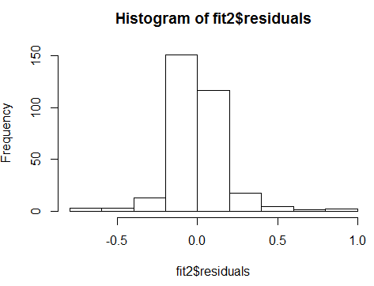
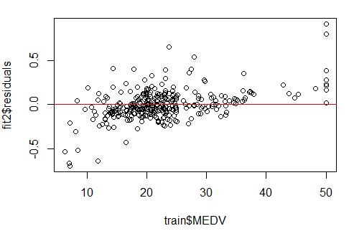
Model Diagnostics (cont’d)
Other assumptions have been executed below and the plots are shown below:
Assumption: Errors are normally distributed.
Assumption: Variance is constant

Slide 23

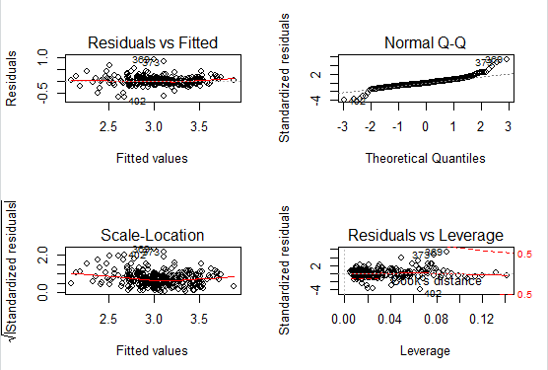
Model Diagnostics (cont’d)
Notes:
Plot 1: This scatter plot shows the distribution of residuals (errors) vs fitted values (predicted values). The line is fairly straight.
Plot 2: This q-q or quantile-quantile is a scatter plot which helps us validate the assumption of normal distribution in a data set. Using this plot we can infer if the data comes from a normal distribution. If yes, the plot would show fairly straight line. Absence of normality in the errors can be seen with deviation in the straight line.
Plot 3: This plot is also used to detect homoskedasticity (assumption of equal variance). It shows how the residual are spread along the range of predictors. It’s similar to residual vs fitted value plot except it uses standardized residual values.
Plot 4: It is also known as Cook’s Distance plot. Cook’s distance attempts to identify the points which have more influence than other points. Such influential points tends to have a sizable impact of the regression line. In other words, adding or removing such points from the model can completely change the model statistics.

Slide 24
Final Conclusion of the Project- Insights derived and Recommendation
Following independent variables were the most significant based on the summary of the model.
In examining the table, unit increase in any of these variables influences the MEDV value. Unit increase in CRIM (crime rate) brings down the house price by (- 0.0133970). Whereas, unit increase in number of rooms (RM), increases the value of the house by 0.18097. Similarly, we can deduce for other variables.
SIGNIFICANT VARIABLES | DESCRIPTION | ESTIMATED COEFFICENTS
CRIM | Crime rate per town | - 0.0133970
CHAS | Houses close to Charles River | 0.1588957
NOX | Nitric Oxide emission | - 0.4567497
RM | Average number of rooms per dwelling | 0.1809727
DIS | Distance to work | - 0.0316789
PTRATIO | Pupil teacher ratio by town | - 0.0277677
B | Proportion of blacks by town | 0.0004492
LSTAT | Percentage of lower status of population | - 0.0247731
Notes:
Unit increase in these variables influences the MEDV value. A unit increase in CRIM (crime rate) brings down the house price by (- 0.0133970). Whereas, a unit increase in number of rooms (RM), increases the value of the house by 0.18097. Similarly, we can deduce for other variables looking at the table.

Slide 25
Final Conclusion of the Project- Insights derived and Recommendation
Insights Derived:
The factors that drive the value of houses in Boston are crime rate, distance from the Charles river, nitric oxide emission, number of rooms, distance from workplace, pupil-teacher ratio, proportion of blacks, and percentage of lower status of population.
The value of houses tend to increase when there are more rooms, and when it is located close to the Charles river. Lower crime rate and lower pupil-teacher ratio also contributed in increasing the value of houses.
The fitted regression model shows that higher levels of pollution decrease house prices to a greater extent than distance to work. Employment zones tend to have higher levels of nitrogen oxide emission. Hence, it is reasonable to think that people would prefer living farther from their workplace if it meant lower levels of pollution.
Our recommendation to client (city council of Boston, MA. ):
Design houses with more number of rooms.
Locate the houses close to the Charles river and preferably distant from the industrial zones.

Slide 26
References
Business requirement provided by IMS PRO in CapStoneProject1_Question.pdf
Boston Housing data provided IMS PRO HousingData.csv
Outlier treatment using IQR rule : http://stamfordresearch.com/outlier-removal-in-r-using-iqr-rule/#comment-43

Slide 27
Thank you
Thank You!

